Slide 1
BrokerLess
Revolutionizing Renting on the Blockchain

Slide 2
Agenda
1
Overview
2
Platform
3
Process
4
Next Steps
5
Questions

Slide 3
Overview

Slide 4
Our Team
Joseph Pasik
Ava Lee
Shereef El-Prince
Kevin Qiu
Kebbin Eke
Lead Developer
Developer
Developer
Developer
Developer

Slide 5
Our Purpose
Create a BrokerLess environment in the leasing space that is trustworthy, fun, virtually free and transparent
"Hakuna Matata"

Slide 6


Our Proposition
Tenants
Previous Tenant
Incentive Fee
Swift Security Deposit return
New Tenant
No Broker Free
Transparency
High yielding interest
BrokerLess
Landlords
Cheaper Fees
Faster Payment
Maximum Rent
Hassle Free
Transparency
Broader Market
Notes:
Compare and contrast the traditional method vs. our method:
Broker Fee: 1 - 2 months (not much room to reduce either because that is split between the company and the broker and fixed costs) vs. less then a ⅓ of monthly rent (money in landlords pocket faster)
Absolute transparency open bid and landlord acceptance vs At the mercy of the broker
Broader horizon vs Broker Horizon in terms of market reach
Encourage Tenant to assist in renting the apartment with money back option vs Broker headache and communication/coordination
Interest from deposit upside vs nothing but expenses from broker
Deposit return timely

Slide 7
Key Challenges
Connecting Contracts
2
Linking the auction contract with the lease agreement and deposit contract
1
3
Frontend Development
Simplifying Contracts
Everything about it
Condensing contracts to eliminate redundancy
4
General Solidity
Integers & Floats
Legal Framework
5
Developing a better understanding of the legal implications

Slide 8
Platform

Slide 9
Our Resources
Solidity
Our main language used for contract development via the remix IDE
Ganache
To manage user wallets and to test account balances for our initial contracts
Visual Studio Code
The second IDE that our team used to connect the backend and frontend
Web3.py
Used to deploy our initial frontend
WiX
Software company providing easy web development services

Slide 10
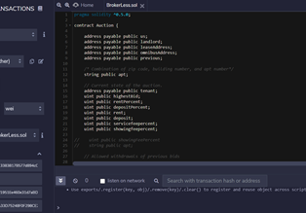

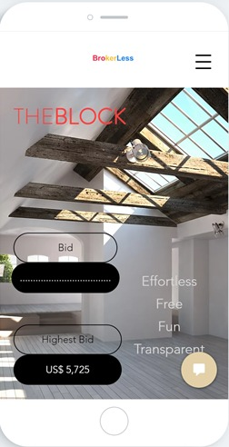
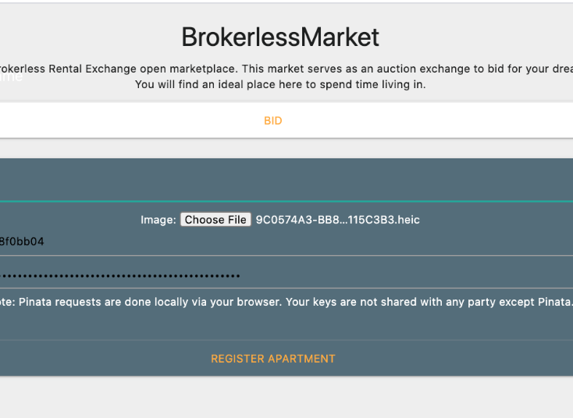
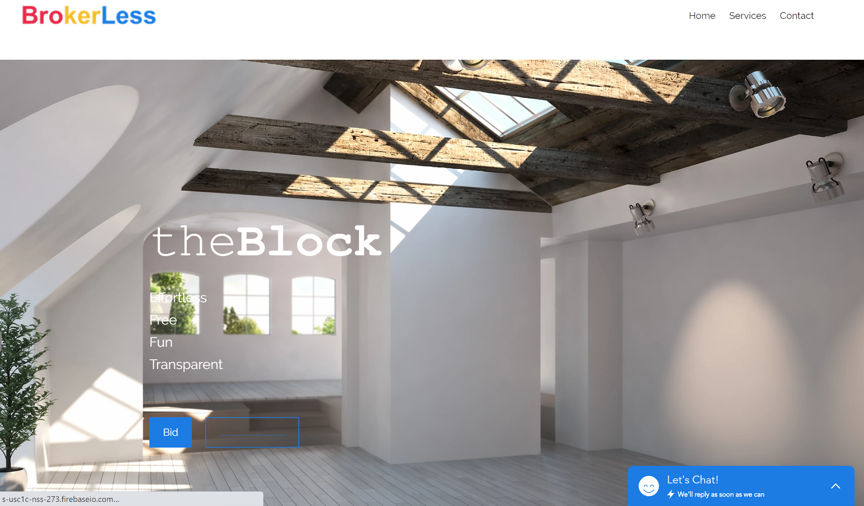
Backend
Our Platform
Frontend
App

Slide 11
Process

Slide 12
Process Overview
Property Listed
Landlords list their property on our platform
1
Auction
2
Prospective tenants bid on properties
Lease Agreement
3
The lease agreement is signed, and a contract is generated
4
Security Deposit
Our platform utilizes smart contracts that safely and securely invest your security deposit

Slide 13







Auction
Rent
Former Tenant
Fees
Deposit
Platform
Feeds into BrokerLess contract (money is split into 3 ways)
Rent payment
Fee payments (2 recipients)
Security deposit payment
The Property Is Listed
The Highest Bidder Wins
View opportunity
Bid on opportunity
Contract created
Notes:
change deposit to security deposit

Slide 14



Lease Agreement
Process
Blockchain
A lease is automatically generated once the landlord accepts the bid, which specifies the duration of the lease, cost of rent, and any other conditions within a standard lease agreement
The contract is stored on the Ethereum blockchain which is a decentralized distributed ledger
Functionality
Security
Tenants: Pay rent through the platform and can receive the security deposit post-contract termination
Landlords: Receive rent payments that are settled almost instantly via the blockchain
All documents and transactions are verifiable and reduce the risk of censorship

Slide 15




Security Deposit
Tenant Deposit
Omnibus Account
Bank / Asset Manager
Contract Initiation
Contract Termination
Once the tenant makes the 1st payment. The money is then deposited into an omnibus account and invested into a high-yielding saving account
2. Upon termination of the contract the security deposit is returned to the tenants

Slide 16
Next Steps

Slide 17





Next Steps
Additional Features
Background Checks & Reviews
1
Background checks for landlords and reviews for all users
There are several additional features that we would like to add to our platform over time. Our team will continue to expand this project.
Expanded Deposit Investment Options
2
ETFs, mutual funds, crypto staking, etc.
More Flexible Payment Features
3
Allow deposit payments to be applied to property damages, late fees, etc.
Timed Contracts
4
Greater timing flexibility for lease duration
Notes:
add in college students taking pictures for the landlord for free (credit for them) + banks and interest rates
Duration of contract
Auction contract should create brokerless contract. Or contract factory for may empty lease contracts to exist in waiting.
Vetting with machine learning
Invest deposit with machine learning
Add damage report for landlord, require picture submission, allow withdrawal of deposit funds
Rather than auction process, bidders should offer rent and deposit fee. Landlord should be able to choose which to accept. Landlord to set minimum.
Add “paper” contract as URI
Allow tenants to offer a higher security deposit that the landlord is allowed to invest (전세) -> more security for the landlord (better tenants)
Link with property listing platform
Late fee (require payRent function even month)
Events in place for javascript Dapps to listen to. For user friendly UI

Slide 18
Additional Developments
Machine Learning
Employ machine learning models to evaluate tenant’s credit worthiness and assign profile evaluations.
Document Support
Incorporate paper URI contracts. Also add events to the property history for repair bills, taxes, and insurance payments
Interconnectedness
Link the platform with affiliate property listing websites.
Security Deposit Loans
Allow tenants to offer a higher security deposit amount that the landlord can invest.
Property Photos
Commission local university photography students to take photos of the property.

Slide 19
Our Testimonials
They are revolutionizing how landlords and tenants connect when buying and selling property rentals
- Landlord / Industry Expert (@Adam Behrman)
As a landlord this platform provides a great opportunity for me to partner with my tenants in a seamless and cost-efficient way
- Landlord / Student Advisor (@David Sison)
I LOVE TEAM 4!
- Top User / Premium Account Holder (Peter Repetto)

Slide 20
Questions

Slide 21
Appendix

Slide 22
Adam Flowchart
When the bid ends the winning bidder pays 3 people
Us (3%)
The Landlord (95%)
The former tenant (2%)
Bank Interest
Property gets listed
Auction for property N.F.T. (Non-Fungible Token)
Deposit amount equal to first month rent
Goes into a joint account but there’s a record of each person's ownership of that account

Slide 23
Technical Flowchart
Auction Contract Deployment The platform launches the auction for the landlord
Contract Close Agreement contract is launched
Close More to come
Landlord Selects The Highest Bidder Write process description here. Write process description here.
Deposit Launched More to come

Slide 24

Process Overview (v2)
Property Listing
Lease Agreement
Contract Termination
Landlords list their property on our platform
Landlord and Tenant sign the lease agreement
At termination of the existing contract the process restarts
Auction
Security Deposit
Prospective tenants bid on properties
The deposit gets invested

Slide 25


Fees
Former Tenant(s)
Landlord
Our Platform
25% of the first month’s rent
Saves 3% on broker fees
5% of the first month’s rent

Slide 26



Lease Terminations
Our Platform allows for a more stable lease termination process.
By incentivizing departing tenants to act as brokers we reduce the operational hassle for landlords who are looking for new tenants, and at a much lower cost

